Slide 1
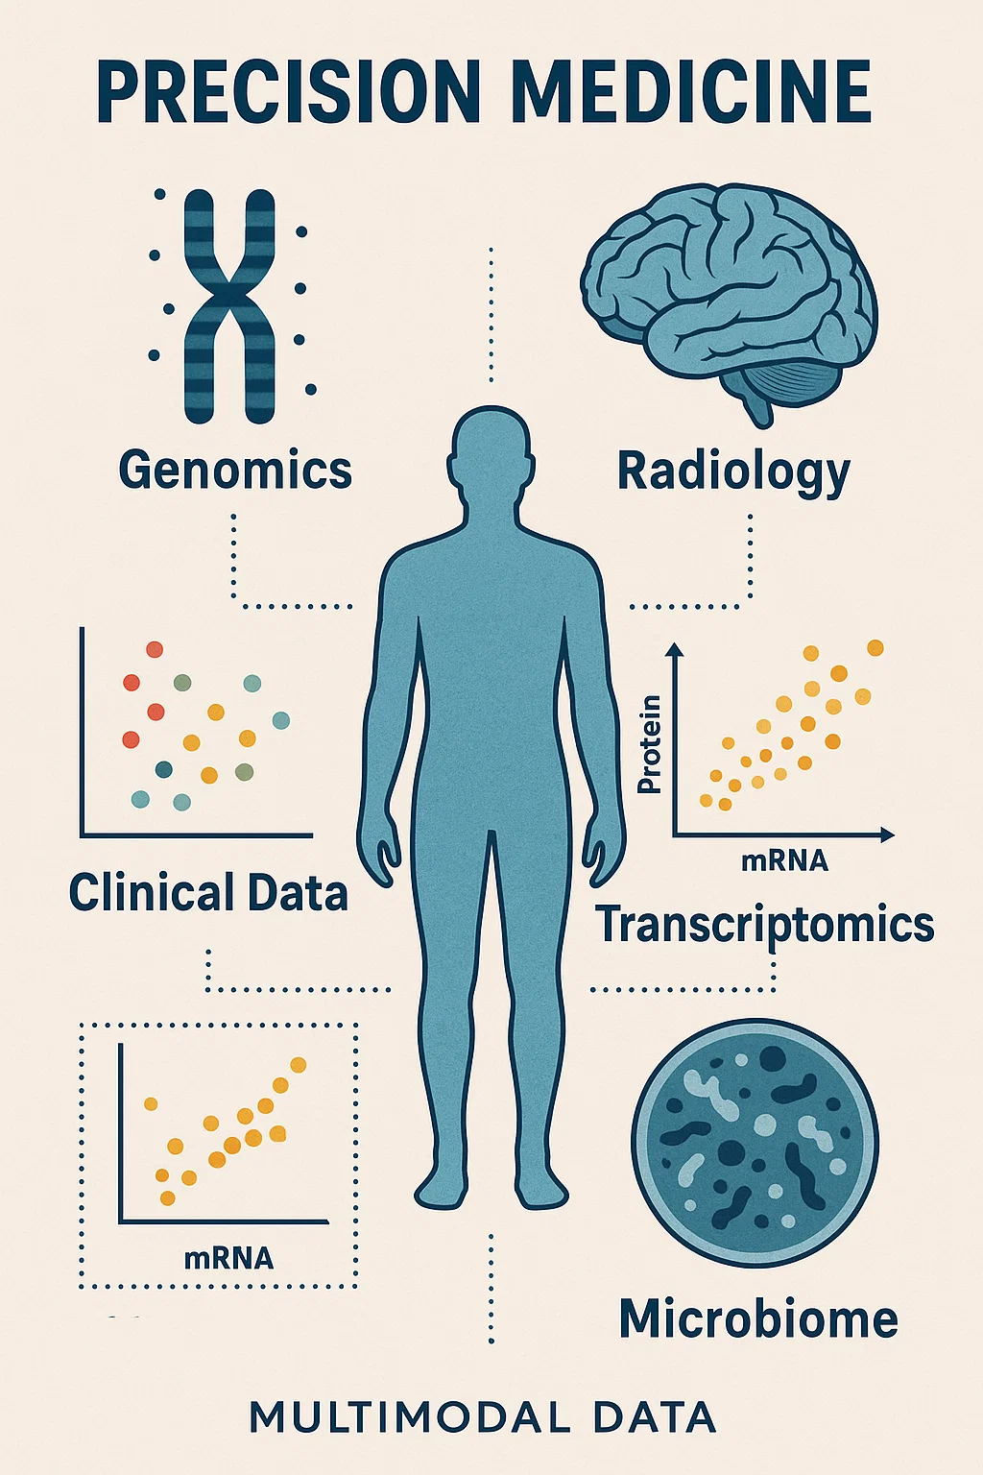
GLBIO 2025
Harnessing Multi-Modal AI Models for Precision Medicine: Transforming Data into Personalized Healthcare Solutions
Danielle S, PhD | Peter S, M.S | Nicole G, MS

Slide 2

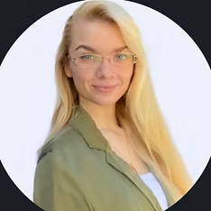
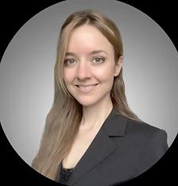
Peter Stover, M.S. Software Engineering, UMN
Dr. Danielle Stover, PhD. Bioinformatics and Computational Biology, UMN
Nicole Griffin, M.S. Bioinformatics and Computational Biology, UMN
Software Engineer
Lead AI Engineer
Senior Bioinformatician
Team Leadership
Website: https://daniellemstover.wixsite.com/glbio2025
Github: maese005/GLBIO-2025

Slide 3
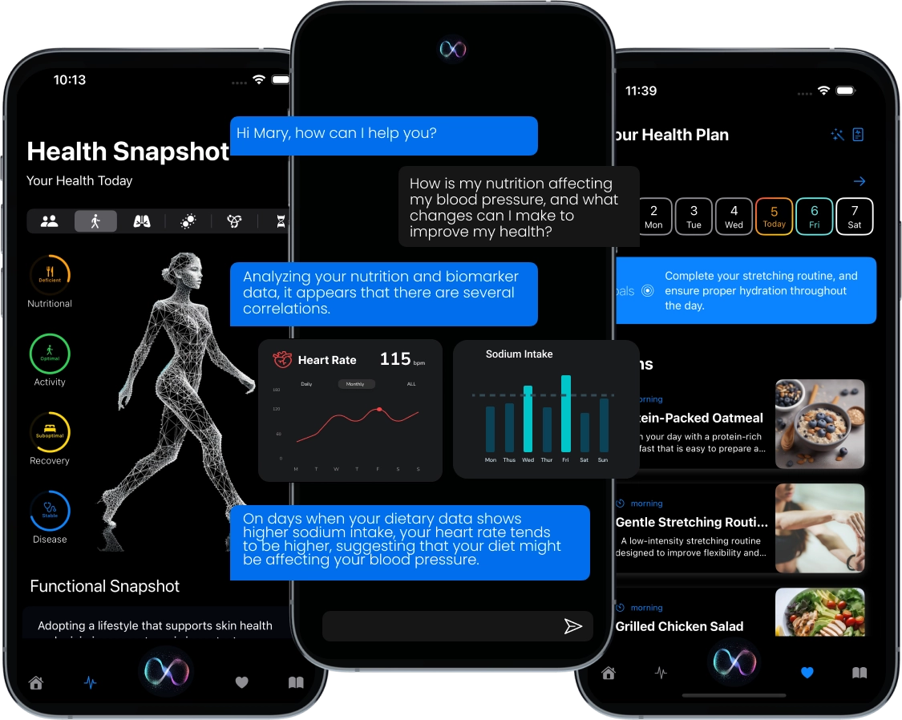
EndurantHealthSpan AI Assistant
Purpose: Streamline healthcare decision-making
Core Capabilities:
Personalized patient risk assessments
Real-time treatment suggestions & alerts
Secure data handling (HIPAA-compliant)
Benefits:
Improves patient outcomes via proactive care
Reduces clinician workload & documentation
Adapts to evolving clinical guidelines
Data:
Medical history
Demographic data
Medication records
Lab and diagnostic records
Lifestyle and social factors

Slide 4
AGENDA
Introduction to Multimodal AI in Precision Medicine
01
04
Transformer Models and Multimodal Data
What is Multimodal AI?
What is Multimodal Data?
What are Key Challenges of Multimodal Data?
Introduction to Transformer Models
Connecting Transformer Models with Multimodal Integration
Coding Exercise 2
02
Multimodal Data Integration
05
Graph Neural Networks and Multimodal Data
Methods and Strategies for Integrating Multimodal Data in Cancer Research
Introduction to Graph Neural Networks
Connecting Graph Neural Networks with Multimodal Integration
Coding Exercise 3
03
Literature Review
06
Closing
Q&A / work session (30 minutes)
What Has Been Done Already?
Let’s Dive Into Their Code
Coding Exercise 1
Break (15 minutes)

Slide 5


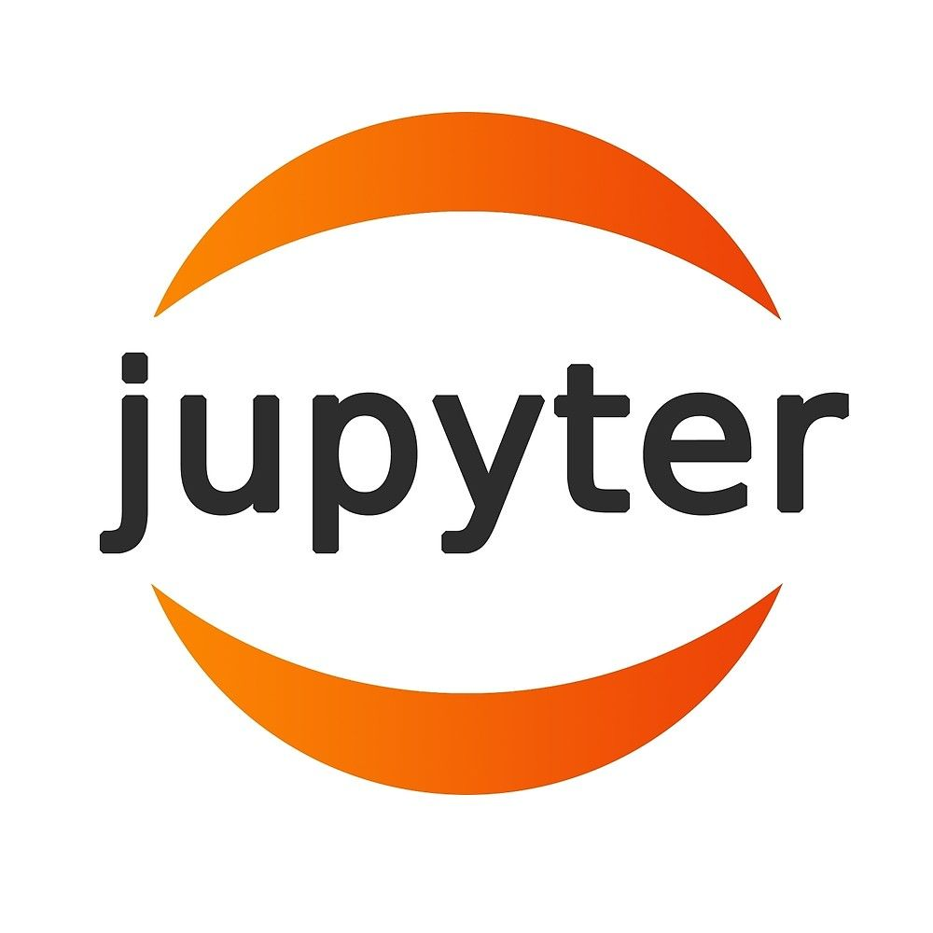
Set Up
Get an internet browser open and ready
Open a python development environment
Website: https://daniellemstover.wixsite.com/glbio2025
Github: maese005/GLBIO-2025

Slide 6
01
Introduction to Multimodal AI in Precision Medicine
What is Multimodal AI?
What is Multimodal Data?
What are Key Challenges of Multimodal Data?

Slide 7
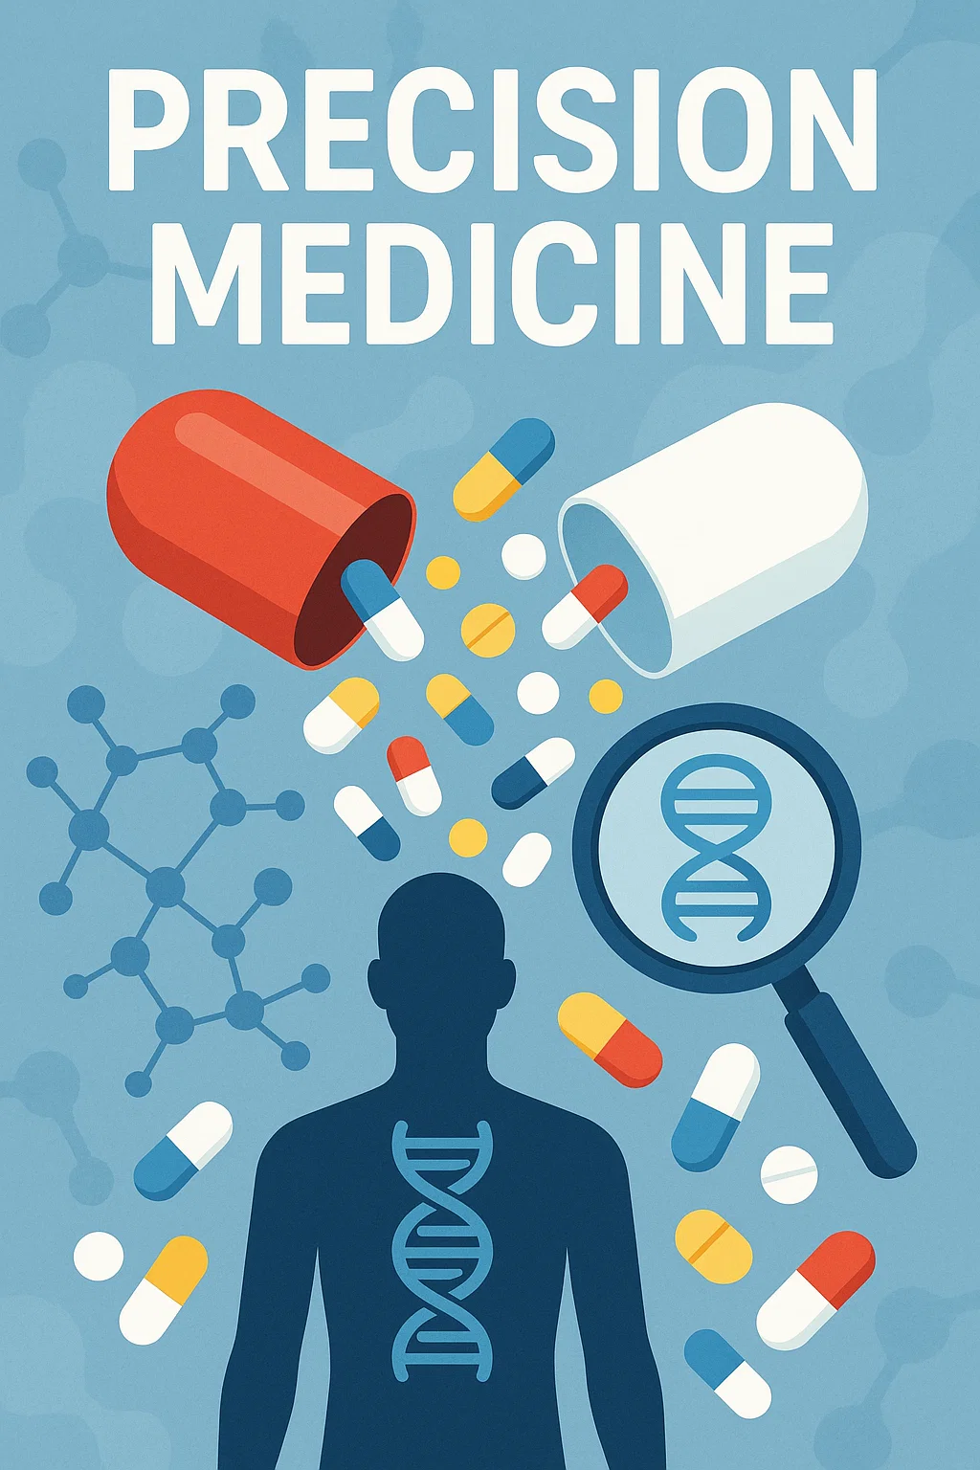
What is Multimodal AI?
What Is Multi-Modal AI?
Integrates diverse data (images, genomics, clinical notes, wearables) into a single predictive framework.
Why It Matters
Improves diagnostic accuracy and personalization of treatments.
Uncovers hidden patterns often missed by single-source approaches.
Key Applications
Cancer Subtyping: Combining scans, genomic variants, and patient history to optimize treatment.
Drug Discovery: Analyzing large multimodal datasets to identify novel therapeutic targets faster.
Takeaways
Ensuring data quality (clean, secure, ethically managed) is critical.
Collaboration among clinicians, data scientists, and bioinformaticians accelerates insights.
Ultimately leads to more personalized, effective healthcare solutions.

Slide 8
What is Multimodal Data?
Definition: Multimodal data refers to the integration and analysis of diverse data types from multiple sources to gain a comprehensive view of a patient’s condition.
Examples in Cancer Research:
Genomic Data: DNA and RNA sequencing, mutation profiles
Imaging Data: MRI, CT scans, PET scans
Histopathology: Microscopic examination of tissue samples
Clinical Records: Patient demographics, medical history, treatment outcomes
Real-time Monitoring: Wearable devices, continuous symptom or biomarker tracking
Why It Matters: By combining these varied datasets, clinicians and researchers can tailor cancer treatment strategies to each patient’s unique molecular and clinical profile—advancing the goal of truly personalized (precision) medicine.
* Multimodal Data and multimodal AI are closely related but not exactly the same. Multimodal data refers to the different types of data sources (e.g., images, text, genomic sequences, clinical data), while multimodal AI refers to the algorithms and models specifically designed to process and integrate those multiple data modalities. Essentially, multimodal data is what you’re working with, and multimodal AI is how you process it.

Slide 9
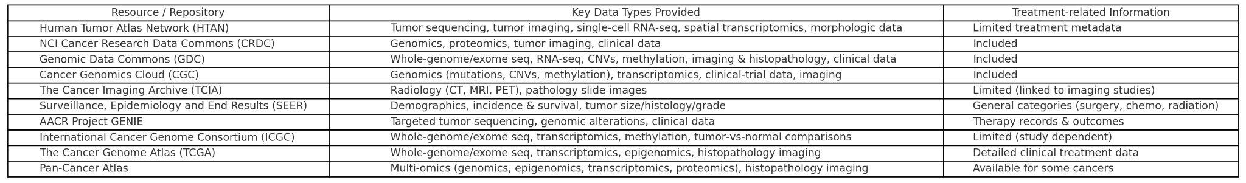
Multimodal Data Sources

Slide 10
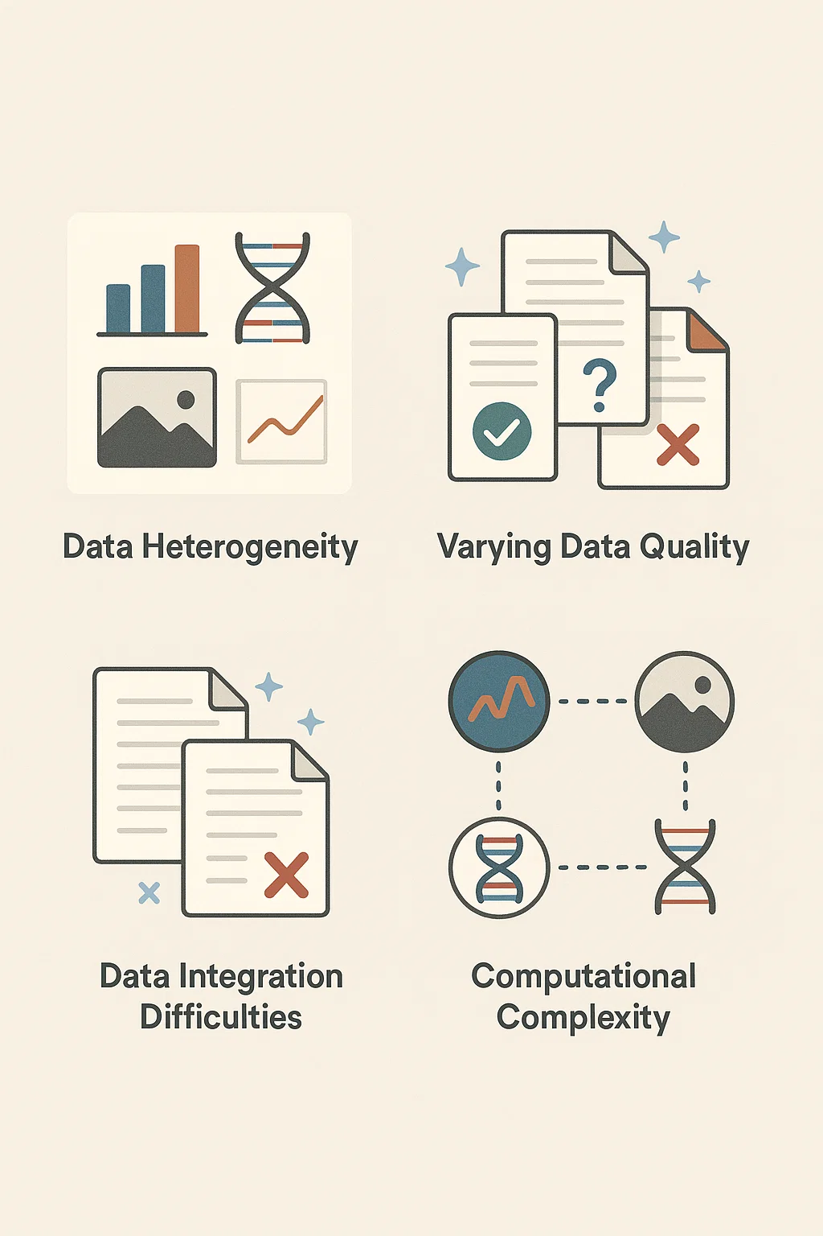
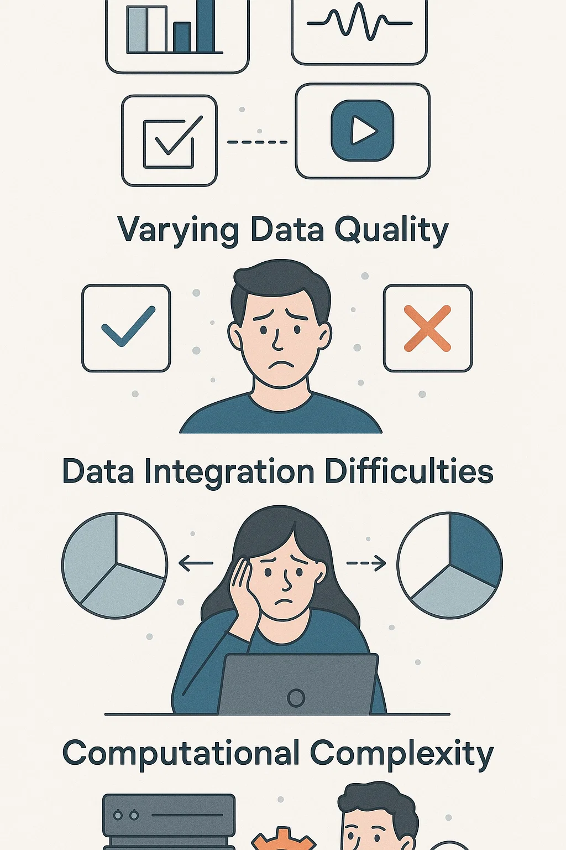
Key Challenges of Multimodal Data
Data Heterogeneity
Different formats (genomic, imaging, clinical)
Requires robust standardization and normalization
Varying Data Quality
Missing or noisy measurements
Demands stringent data cleaning and validation practices
Data Integration Difficulties
Combining multiple data streams into a single framework
Necessitates specialized fusion methods and careful alignment
Computational Complexity
Large datasets and high-dimensional features
Calls for scalable computing resources and efficient algorithms
Real-World Case Studies
Illustrate the above challenges in practical scenarios
Highlight proven strategies to mitigate these issues

Slide 11
02
Multimodal Data Integration
Methods and Strategies for Integrating Multimodal Data in Cancer Research

Slide 12
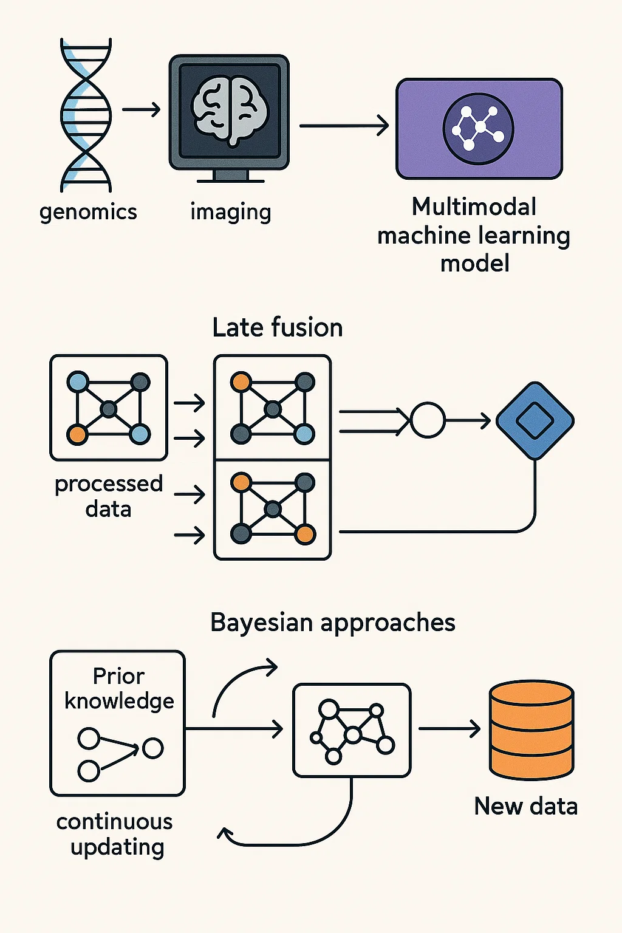
Methods and Strategies for Integrating
Multimodal Data
Multimodal Machine Learning Model: Combine disparate data sources (e.g., genomics, imaging, clinical notes) into unified predictive frameworks.
Late Fusion Techniques: Integrate processed data from independent models toward the end of the pipeline for comprehensive decision-making.
Bayesian Approaches: Incorporate prior knowledge (e.g., known biomarker relationships) and continuously update the model as new data becomes available.
Preprocessing Techniques: Standardize, normalize, and clean each data type to ensure consistent quality and robust downstream analyses.
Collaborative Frameworks: Encourage cross-disciplinary teamwork among oncologists, data scientists, bioinformaticians, and statisticians to achieve integrated insights.
Data Stewardship and Governance: Implement secure protocols, ethical guidelines, and compliance measures (e.g., HIPAA, GDPR) to safeguard patient data and maintain data integrity.
Reference: Harnessing multimodal data integration to advance precision oncology

Slide 13
Types of Multimodal Machine Learning Models
Early Fusion Models:
Concatenate features from different modalities at the outset
Learn from combined inputs from the beginning
Late Fusion Models:
Train unimodal models separately
Combine predictions or features at the end
Maximize the strengths of each data type
Intermediate Fusion Models:
Represent each modality individually
Model interactions across modalities before a joint final output
Capture cross-modal relationships more explicitly
Generative Models:
Investigate relationships among multimodal signals
Generate hypotheses about data interactions (e.g., new phenotypes or mechanisms)
Unsupervised Learning Approaches:
Use Bayesian topic models or clustering to stratify patients
Identify hidden patterns or risk groups
Deep Learning Architectures:
Handle large, heterogeneous feature sets
Provide powerful representations for improved accuracy
Require substantial data to avoid overfitting

Slide 14
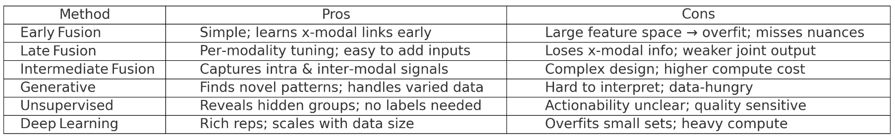

Slide 15
When To Use Each Multimodal Machine Learning Model
Early Fusion
When you want to learn joint representations from the start
Works best with balanced datasets and strong preprocessing
Late Fusion
Ideal if each modality can be developed independently
Simplifies adding or removing modalities without retraining everything
Intermediate Fusion
Useful for capturing both individual and cross-modal relationships
Best when you can handle the added complexity and computational demands
Generative Models
Suited for exploring hidden interactions or generating new hypotheses
Requires larger datasets to effectively learn complex distributions
Unsupervised Learning
Great for discovering new patient subgroups or unknown patterns
Works well when labeling data is impractical or costly
Deep Learning Architectures
Appropriate when you have abundant data across multiple modalities
Can uncover complex patterns but risks overfitting if data is limited

Slide 16
03
Literature Review
What Has Been Done Already?
Exercise 1

Slide 17
What Has Been Done Already?
Sept 2021: Multimodal deep learning models for the prediction of pathologic response to neoadjuvant chemotherapy in breast cancer | Scientific Reports
Oct 2024: M2Fusion: Multi-time Multimodal Fusion for Prediction of Pathological Complete Response in Breast Cancer | SpringerLink
Jan 2025: Decoding pan-cancer treatment outcomes using multimodal real-world data and explainable artificial intelligence | Nature Cancer

Slide 18
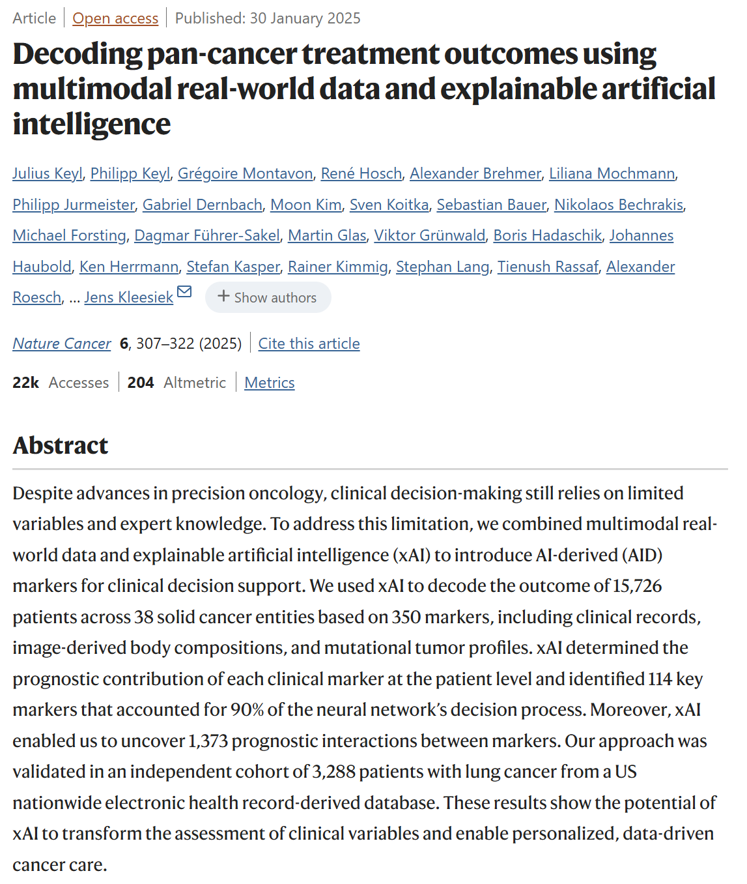
Jan 2025:
Decoding pan-cancer treatment outcomes using multimodal real-world data and explainable artificial intelligence | Nature Cancer

Slide 19
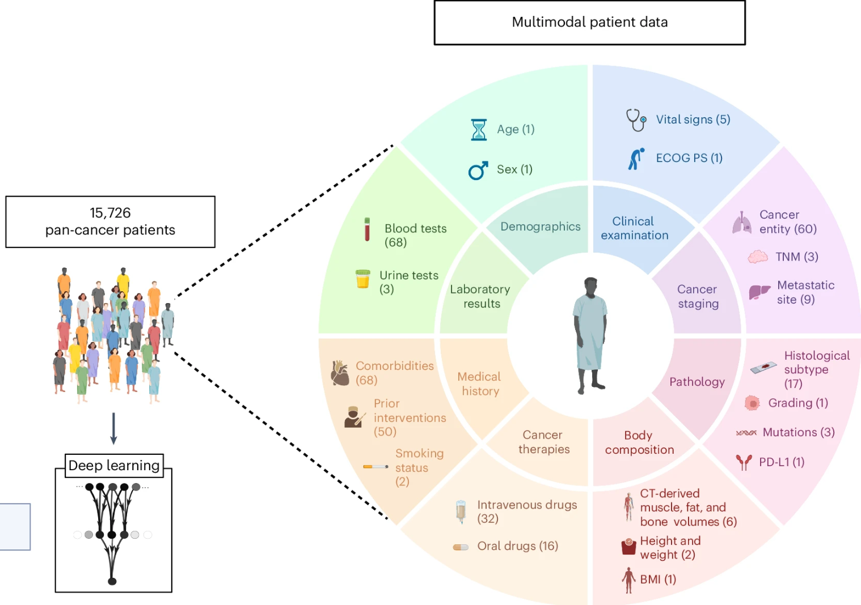
Overview:
Study Overview
Integrated large-scale, real-world data (clinical, imaging, genomic) from 15,726 patients spanning 38 solid tumors
Used deep neural networks and layer-wise relevance propagation (LRP) to generate “AI-derived” markers
Key Findings
Outperformed single-cancer or simpler prognostic models
Identified 114 key markers and uncovered 1,373 interactions relevant to outcomes
Validated on an external cohort of 3,288 patients with lung cancer
Impact
Demonstrates the potential of explainable AI to reveal individualized, data-driven insights
Offers a transparent, patient-level approach to inform personalized cancer treatment decisions

Slide 20
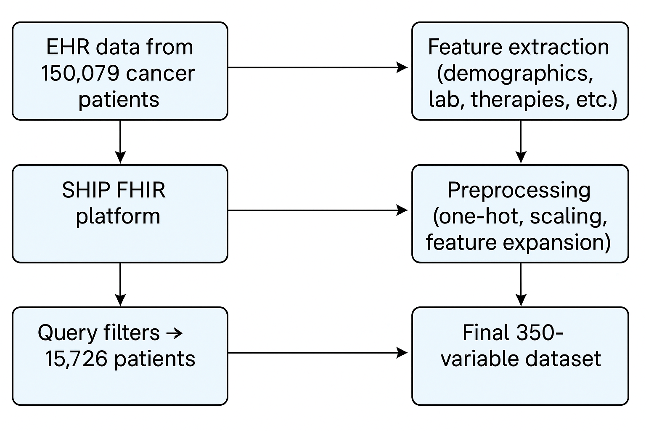
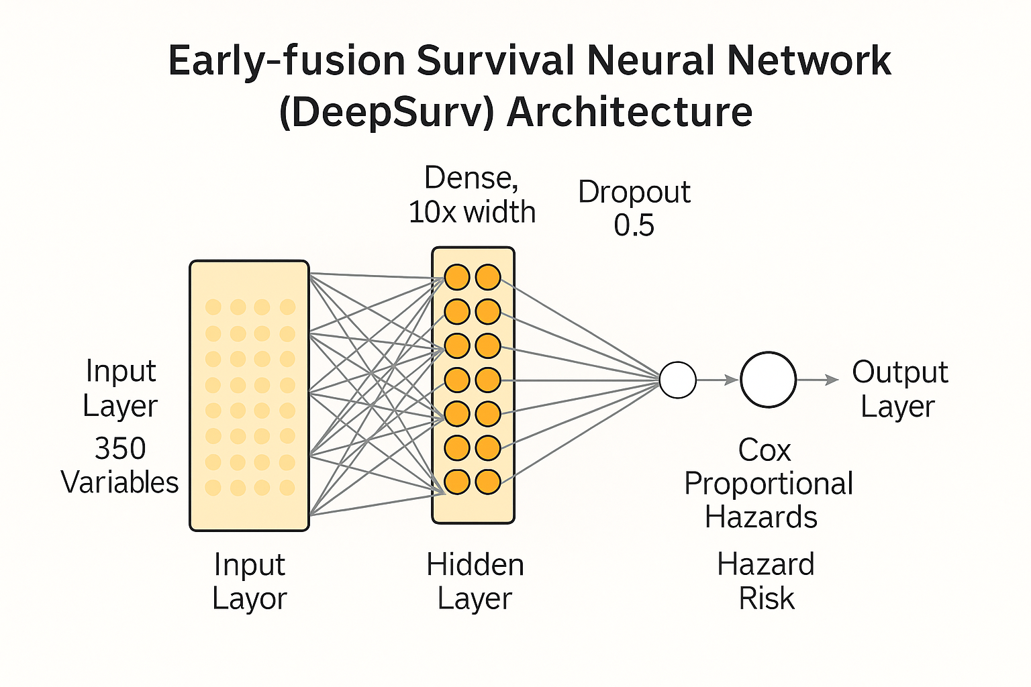
Integration:
Single Deep Neural Network (Early Fusion):
All data types (clinical variables, imaging features, genomic markers, etc.) were transformed into numeric variables and fed into the same model from the outset.
Preprocessing & Standardization:
Continuous variables (e.g., lab values) were standardized (z-score).
Categorical markers (e.g., diagnoses, ICD codes) were one-hot encoded.
Feature expansion tags missing values to preserve the distinction between ‘true zero’ and ‘no data.’
Cohesive Predictive Framework:
The neural network learned interactions across all 350 variables simultaneously.
Handled diverse data (clinical, imaging, genomics) in a unified way, leveraging a cohesive, pan-cancer model for outcome prediction.

Slide 21
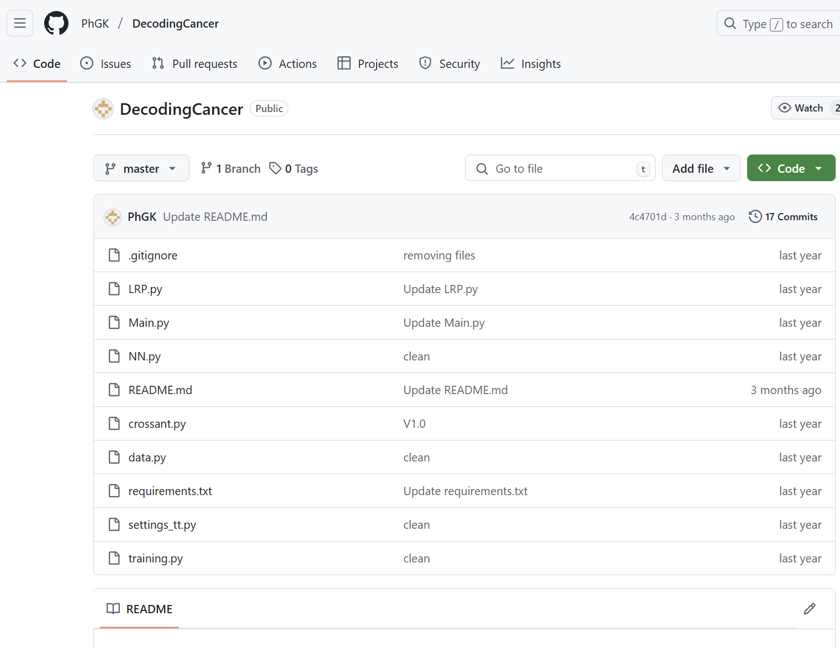
Lets Dive into Their Code
Link: PhGK/DecodingCancer
Data will prepared in data.py and loaded. Here, this is a artificial dataset in which the outcome depends on a single variable.
Run: python Main.py
Data is prepared in data.py and loaded
The crossvalidate function will split data into five folds and start the neural network training on the pan cancer data, the neural network (NN.py) training on the single entity cancer data LRP computation based on the trained model from the pan cancer training

Slide 22
Lets Dive into Their Code: Part 1, Data Generation (data.py)
DecodingCancer/data.py at master · PhGK/DecodingCancer

Slide 23
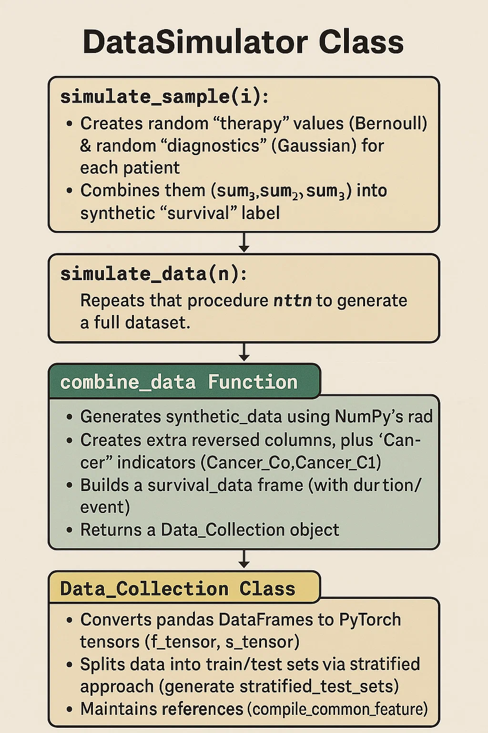
Part 1 Details
Take Home: This script is a foundation for producing and splitting up synthetic data to test your machine learning pipeline, ensuring you have consistent shapes, train/test splits, and reproducibility.
DecodingCancer/data.py at master · PhGK/DecodingCancer

Slide 24
Lets Dive into Their Code: Part 2 (NN.py)
DecodingCancer/NN.py at master · PhGK/DecodingCancer

Slide 25
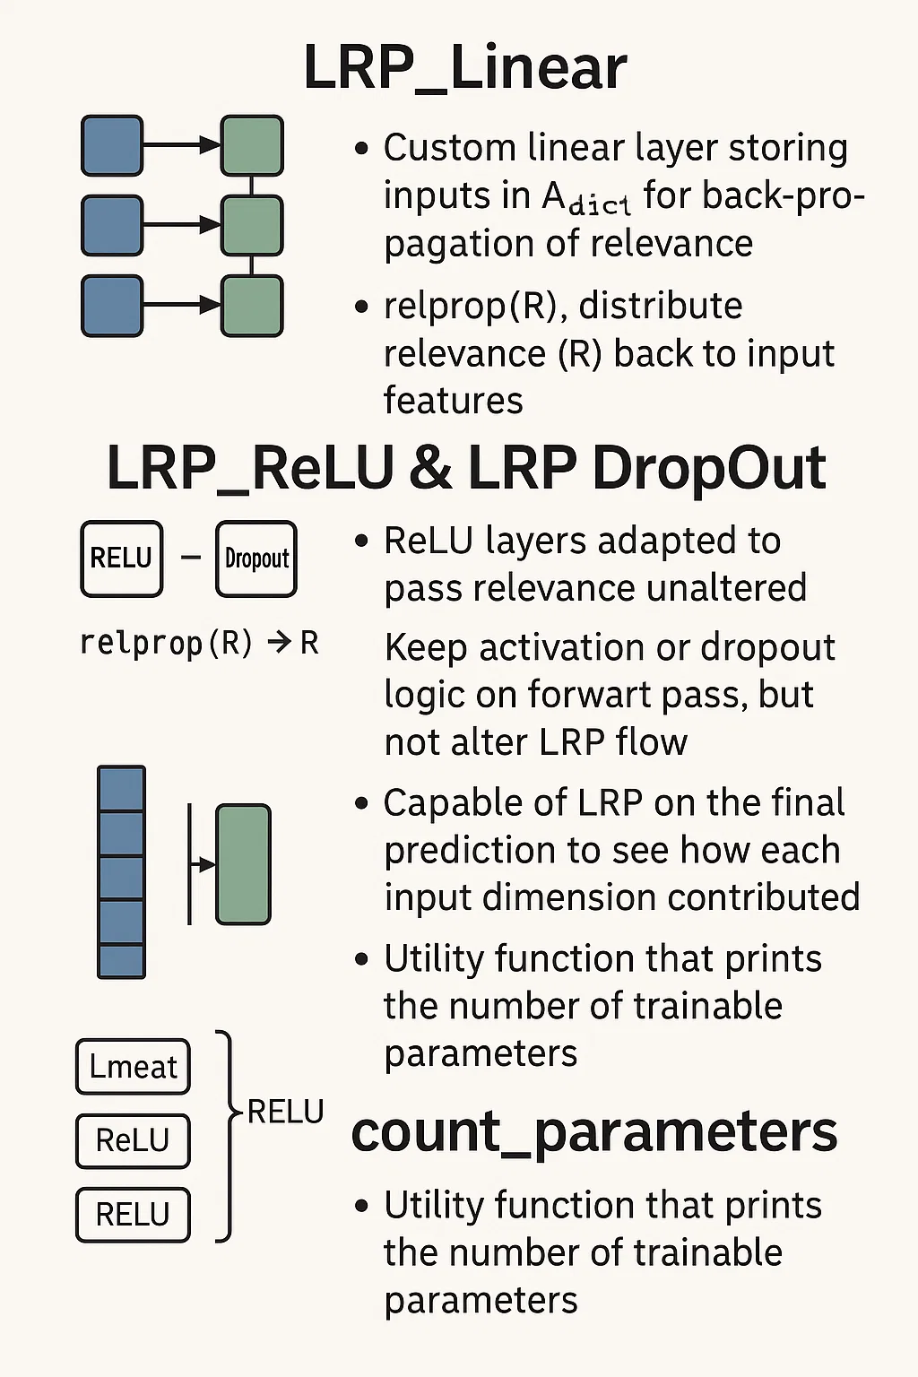
Part 2: Details
Take Home: the script primarily implements a feed-forward neural network (the "Simple_Model") with Layer-Wise Relevance Propagation (LRP). Although it includes a class called LRP_cat, which can concatenate multiple tensors for “fusion,” that fusion step is not directly wired into "Simple_Model" by default.
DecodingCancer/NN.py at master · PhGK/DecodingCancer

Slide 26
Exercise 1: Recreate the Multimodal Data Integration Method Used in the Paper ( a simpler version)
Understand their approach:
They combined clinical records, imaging-derived features, and genomic data for outcome prediction.
Used deep learning (early fusion approach) to integrate multimodal features into a single predictive model.
Applied explainable AI (xAI) techniques to interpret model decisions.
Define a dummy dataset with:
Clinical Data (e.g., age, comorbidities, ECOG score)
Imaging Features (e.g., body composition metrics extracted from CT scans)
Genomic Data (e.g., mutation markers, gene expression)
Preprocess the data:
Standardization & one-hot encoding where needed.
Handling missing values.
Build a multimodal deep learning model that:
Takes all these inputs in a unified format.
Uses early fusion (concatenating all feature types before passing them to the model).
Predicts an outcome (e.g., survival, treatment response).
Use explainability techniques to interpret predictions.
GLBIO-2025/fusion_ai_cancer.py at main · maese005/GLBIO-2025

Slide 27
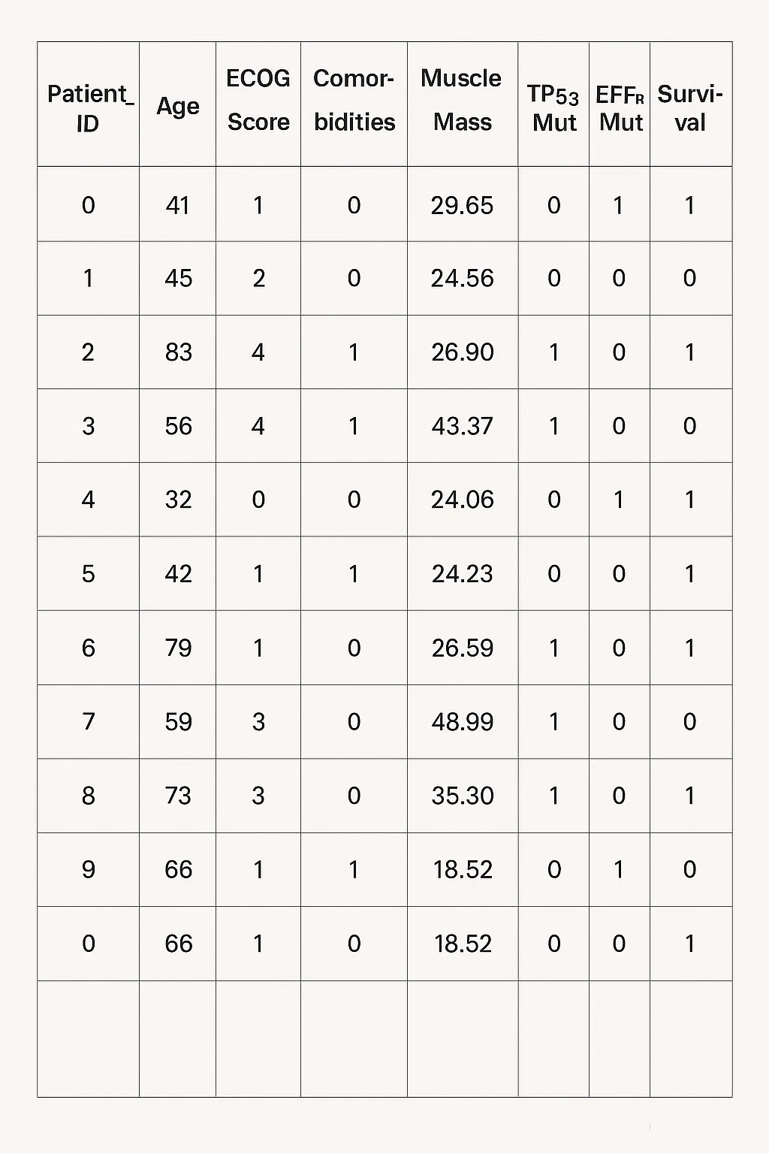
Step 1: Generate Dummy Multimodal Data
# Import modules
import tensorflow as tf
from tensorflow import keras
from tensorflow.keras import layers
from sklearn.preprocessing import StandardScaler, OneHotEncoder
from sklearn.model_selection import train_test_split
import shap
# Set random seed for reproducibility
np.random.seed(42)
# Number of samples (patients)
num_samples = 1000
# Generate Clinical Data
clinical_data = pd.DataFrame({
"Patient_ID": range(num_samples),
"Age": np.random.randint(30, 85, size=num_samples),
"ECOG_Score": np.random.choice([0, 1, 2, 3, 4], size=num_samples),
"Comorbidities": np.random.choice([0, 1], size=num_samples), # 0 = No, 1 = Yes
})
# Generate Imaging Data (CT-based body composition, scaled to arbitrary units)
imaging_data = pd.DataFrame({
"Patient_ID": range(num_samples),
"Muscle_Mass": np.random.uniform(10, 50, size=num_samples),
"Visceral_Fat": np.random.uniform(5, 30, size=num_samples),
"Subcutaneous_Fat": np.random.uniform(10, 40, size=num_samples),
})
# Generate Genomic Data (Mutations as binary indicators)
genomic_data = pd.DataFrame({
"Patient_ID": range(num_samples),
"TP53_Mut": np.random.choice([0, 1], size=num_samples), # 1 = mutation present
"EGFR_Mut": np.random.choice([0, 1], size=num_samples),
"KRAS_Mut": np.random.choice([0, 1], size=num_samples),
})
# Merge all datasets on Patient_ID
merged_df = clinical_data.merge(imaging_data, on="Patient_ID").merge(genomic_data, on="Patient_ID")
# Generate Survival Outcome (Binary classification: 1 = Survived, 0 = Died)
merged_df["Survival"] = np.random.choice([0, 1], size=num_samples, p=[0.3, 0.7]) # 70% survival rate

Slide 28
Step 2: Preprocessing
Numerical features: apply z-score scaling to prevent variables with larger native ranges (e.g. muscle mass vs age) from dominating the model
Categorical features: pass through OneHotEncoder, turning each possible category value into its own binary column
ECOG score of 2 becomes a 1 in ECOG_Score_2 column and 0 everywhere else
Concatenate the processed features to yield a single matrix
# Select feature columns
numerical_features = ["Age", "Muscle_Mass", "Visceral_Fat", "Subcutaneous_Fat"]
categorical_features = ["ECOG_Score", "Comorbidities", "TP53_Mut", "EGFR_Mut", "KRAS_Mut"]
target_column = "Survival"
# Scale numerical features
scaler = StandardScaler()
merged_df[numerical_features] = scaler.fit_transform(merged_df[numerical_features])
# One-hot encode categorical features
encoder = OneHotEncoder(sparse_output=False)
encoded_cat_features = encoder.fit_transform(merged_df[categorical_features])
encoded_cat_df = pd.DataFrame(encoded_cat_features, columns=encoder.get_feature_names_out(categorical_features))
# Concatenate processed data
X = pd.concat([merged_df[numerical_features], encoded_cat_df], axis=1)
y = merged_df[target_column]
# Split into training and test sets
X_train, X_test, y_train, y_test = train_test_split(X, y, test_size=0.2, random_state=42)

Slide 29
Step 3:
Build a Multimodal
Deep Learning Model
# Define input shape
input_shape = X_train.shape[1]
# Build the deep learning model
model = keras.Sequential([
layers.Input(shape=(input_shape,)),
layers.Dense(64, activation="relu"),
layers.Dense(32, activation="relu"),
layers.Dense(16, activation="relu"),
layers.Dense(1, activation="sigmoid") # Binary classification (Survival)
])
# Compile the model
model.compile(optimizer="adam", loss="binary_crossentropy", metrics=["accuracy"])
# Train the model
model.fit(X_train, y_train, epochs=10, batch_size=32, validation_data=(X_test, y_test))
# Step 4: Model Explainability using SHAP
# To make the model interpretable, we use SHAP (SHapley Additive Explanations).
# Create SHAP explainer
explainer = shap.Explainer(model, X_train)
# Compute SHAP values
shap_values = explainer(X_test)
# Visualize feature importance
shap.summary_plot(shap_values, X_test)
Feed engineered feature matrix into neural net
Input layer matches number of features
Three hidden layers (64, 32, 16 neurons)
Sigmoid output gives survival probability
Compiled with Adam and binary cross entropy
SHAP assigns each feature a Shapley value

Slide 30
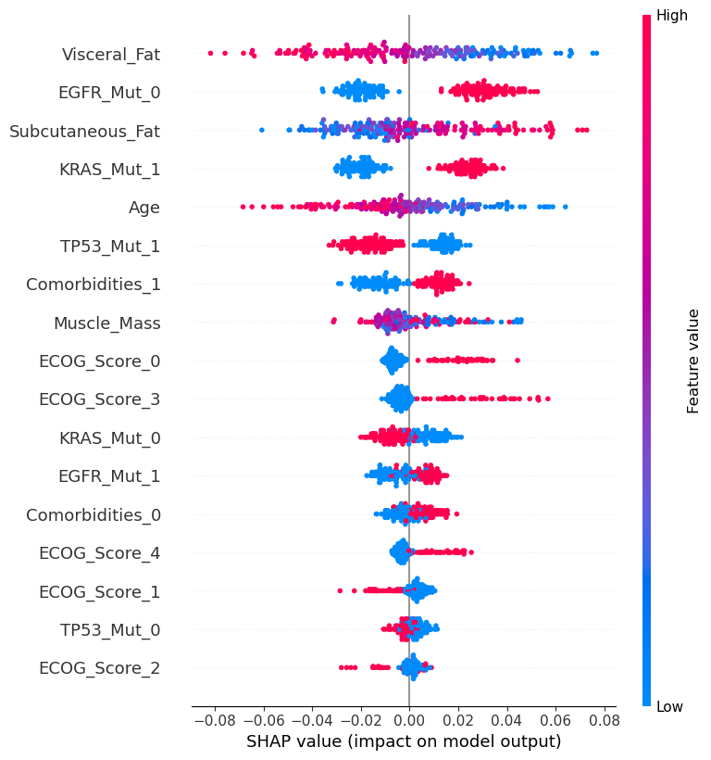
Age dominates. It’s the top bar, and notice the gradient: red dots on the left, blue on the right. Older age (red) consistently drags the survival probability lower, while younger age (blue) pushes it higher—exactly what we’d expect clinically.
Body‑composition matters. Muscle Mass and Visceral Fat sit high on the list. Higher muscle mass shifts dots right—better survival—whereas higher visceral fat nudges them left, indicating risk.
Performance status shows up. Several ECOG one‑hot columns cluster next. A score of 0 or 1 drives good outcomes, while scores 3 and 4 lean heavily negative.
Genomic signals add nuance. TP53 and KRAS mutations both appear: red dots for a positive mutation skew left, reflecting poorer prognosis, while the absence of mutation often helps.
Comorbidity flag rounds it out. Patients with additional conditions (red) sit mostly on the left—again matching intuition.

Slide 31
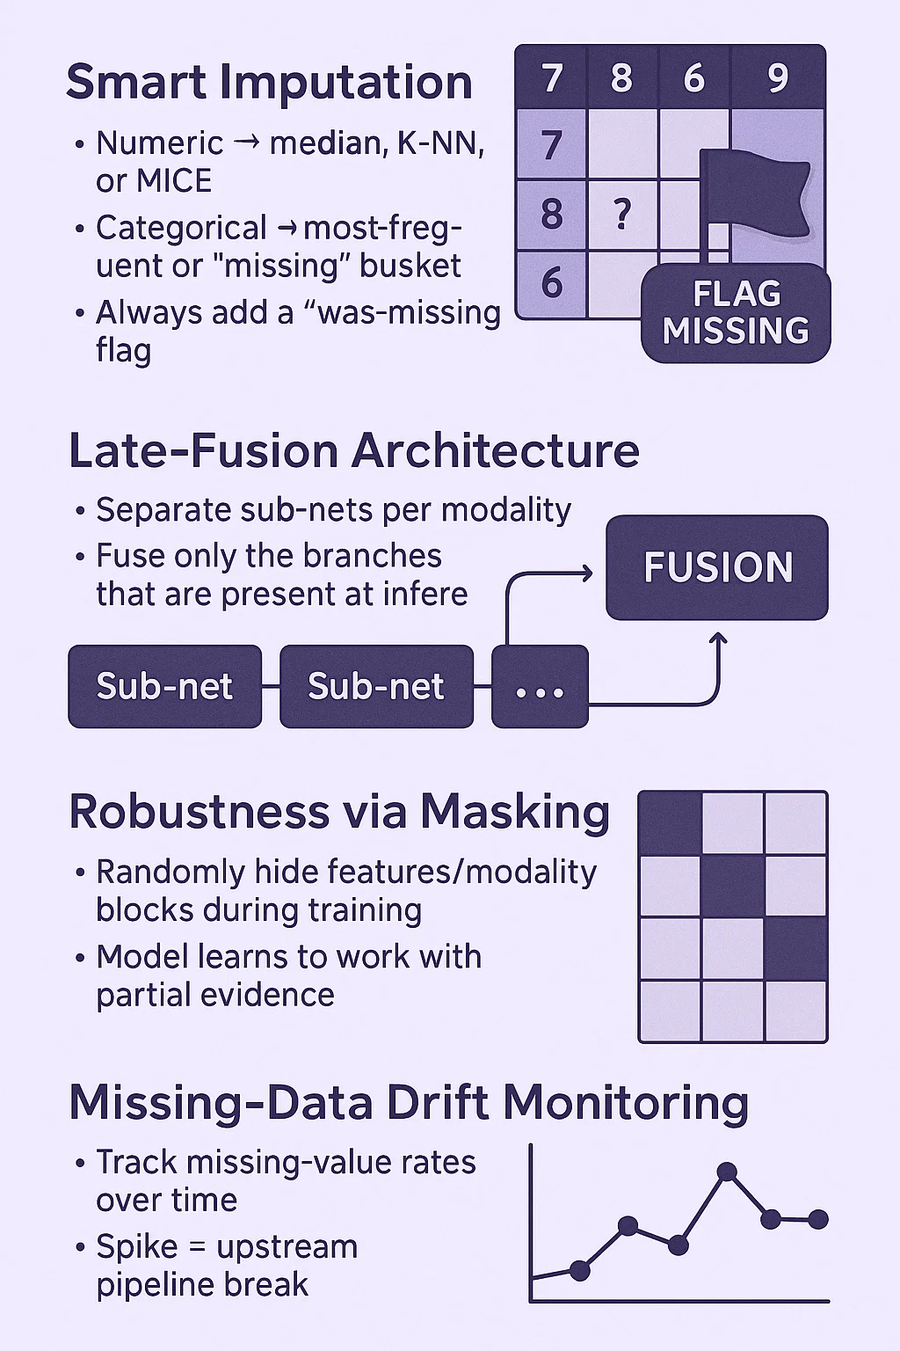
What About Missingness?
Smart Imputation
Numeric → median, K‑NN, or MICE
Categorical → most‑frequent or “missing” bucket
Always add a “was‑missing” flag
Late‑Fusion Architecture
Separate sub‑nets per modality
Fuse only the branches that are present at inference
Robustness via Masking
Randomly hide features/modality blocks during training
Model learns to work with partial evidence
Missing‑Data Drift Monitoring
Track missing‑value rates over time
Spike = upstream pipeline break
GLBIO-2025/fusion_ai_cancer_missingness.py at main · maese005/GLBIO-2025

Slide 32
Break
15 minutes

Slide 33
04
Transformer Models and Multimodal Data
Introduction to Transformers
Connecting Transformer Models with Multimodal Integration
Exercise 2

Slide 34
Introduction to Transformer Models
What is a Transformer?
A deep learning architecture introduced by Vaswani et al. (2017).
Designed primarily for natural language processing, but now applied to various data types.
Known for its ability to capture long-range dependencies and contextual information.
Key Concept: Self-Attention
Allows each position in a sequence to attend to every other position.
Learns which parts of the input sequence are most relevant to each token.
Improves parallelization and reduces the limitations of sequential processing.
Why Transformers Matter
Scalability: Easily parallelizable, making it effective for large datasets.
Adaptability: Extended to handle multimodal inputs (text, images, genomic data).
Performance: State-of-the-art results in many domains, including language, vision, and speech.
Relevance to Precision Medicine
Integration of Diverse Data: Transformers can fuse structured (genomic, clinical) and unstructured (text, imaging) data.
Personalized Insights: Self-attention can highlight relevant data for individualized treatment recommendations.
Accelerated Discovery: Enables more efficient analysis of complex biomedical information.

Slide 35
Connecting Transformer Models with Multimodal Integration
Multimodal ML Model: Transformers can ingest various data types (text, images, omics) via specialized embeddings and unified attention layers.
Late Fusion: Separate encoders for each modality feed into a Transformer-based attention or final dense layers, aligning with late-fusion strategies.
Bayesian Approaches: Prior biomarker knowledge can guide Transformers via specialized attention masks or parameter initialization, enabling adaptive model updates.
Preprocessing: Standardizing and cleaning inputs is vital for accurate embeddings, ensuring reliable representations across data types.
Collaborative Frameworks: Cross-disciplinary teams determine what modalities to include and how to encode them, maximizing Transformers’ effectiveness for clinical insights.
Data Stewardship and Governance: Secure data handling (HIPAA, GDPR) is critical, given Transformers typically require large, sensitive patient datasets for robust training.

Slide 36
Exercise 2: transformer_based_late_fusion_for_multimodal_precision_medicine.py
GLBIO-2025/transformer_based_late_fusion_for_multimodal_precision_medicine.py at main · maese005/GLBIO-2025

Slide 37
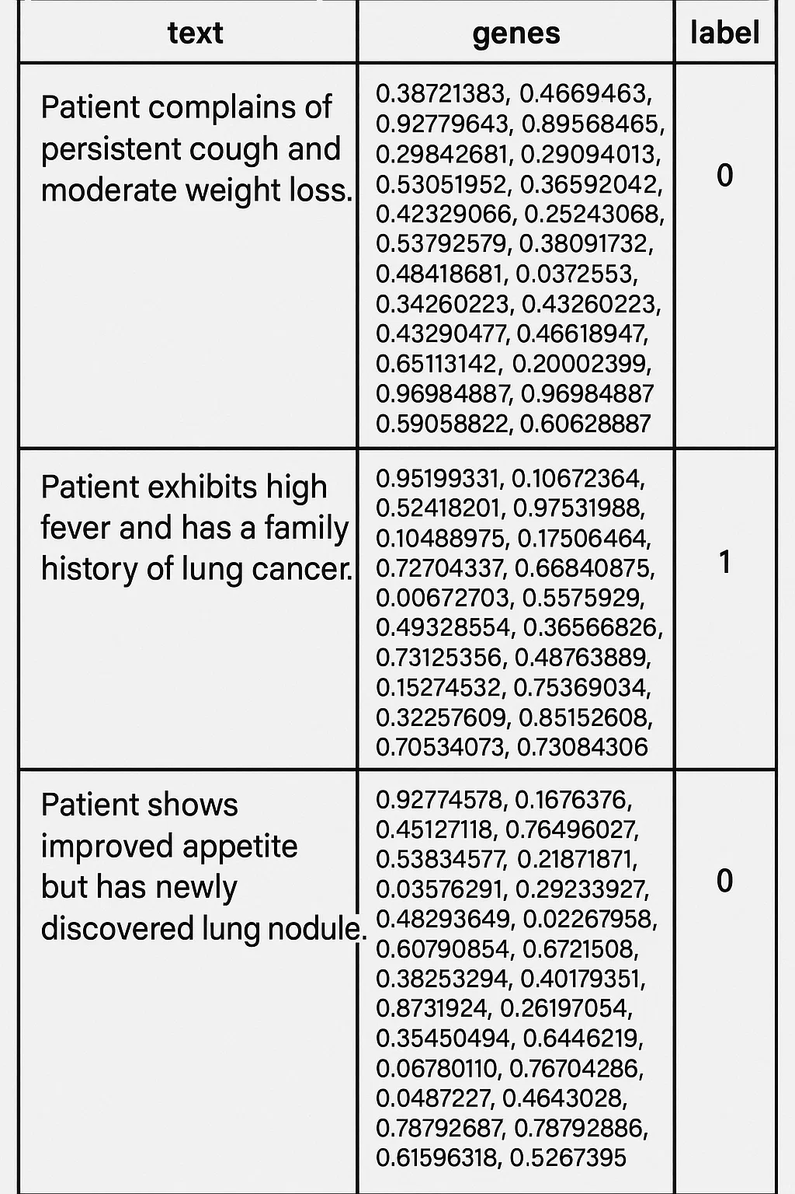
Step 1: Prepare Dummy Data
# Example dummy data
dummy_data = [
{
"text": "Patient complains of persistent cough and moderate weight loss.",
"genes": np.random.rand(50), # 50-gene expression vector
"label": 0
},
{
"text": "Patient exhibits high fever and has a family history of lung cancer.",
"genes": np.random.rand(50),
"label": 1
},
{
"text": "Patient shows improved appetite but has newly discovered lung nodule.",
"genes": np.random.rand(50),
"label": 0
},
# ... more records ...
]
class MultiModalDataset(Dataset):
def __init__(self, data):
self.data = data
def __len__(self):
return len(self.data)
def __getitem__(self, idx):
item = self.data[idx]
text = item["text"]
genes = item["genes"]
label = item["label"]
return text, torch.tensor(genes, dtype=torch.float32), label
# Create dataset and dataloader
dataset = MultiModalDataset(dummy_data)
dataloader = DataLoader(dataset, batch_size=2, shuffle=True)

Slide 38
Step 2: Define the Late Fusion Model
class MockTextTransformer(nn.Module):
"""A stub representing a Transformer-based text encoder (like BERT)."""
def __init__(self, vocab_size=1000, embed_dim=32, hidden_dim=64):
super(MockTextTransformer, self).__init__()
# Embedding + a small linear "Transformer" block for demonstration
self.embedding = nn.Embedding(vocab_size, embed_dim)
self.linear = nn.Linear(embed_dim, hidden_dim)
def forward(self, token_ids):
# In reality, you'd do attention, multi-head layers, etc.
embedded = self.embedding(token_ids) # [batch, seq_len, embed_dim]
# We'll just take a mean pooling over the sequence dimension
embedded_mean = embedded.mean(dim=1) # [batch, embed_dim]
output = torch.relu(self.linear(embedded_mean)) # [batch, hidden_dim]
return output
class GeneExpressionEncoder(nn.Module):
"""Encode gene-expression vectors through a small MLP."""
def __init__(self, input_dim=50, hidden_dim=32):
super(GeneExpressionEncoder, self).__init__()
self.fc1 = nn.Linear(input_dim, hidden_dim)
def forward(self, x):
# A single layer for demonstration
return F.relu(self.fc1(x))
class LateFusionModel(nn.Module):
def __init__(self, text_hidden_dim=64, gene_hidden_dim=32, num_classes=2):
super(LateFusionModel, self).__init__()
# Mock transformer and gene MLP
self.text_encoder = MockTextTransformer(hidden_dim=text_hidden_dim)
self.gene_encoder = GeneExpressionEncoder(hidden_dim=gene_hidden_dim)
# Fusion layer: simply concatenate the encoded text + gene representations
fused_input_dim = text_hidden_dim + gene_hidden_dim
self.fusion = nn.Linear(fused_input_dim, num_classes)
def forward(self, token_ids, gene_vec):
text_features = self.text_encoder(token_ids)
gene_features = self.gene_encoder(gene_vec)
# Late-fusion: combine both representations
fused = torch.cat([text_features, gene_features], dim=1)
output = self.fusion(fused) # [batch_size, num_classes]
return output

Slide 39
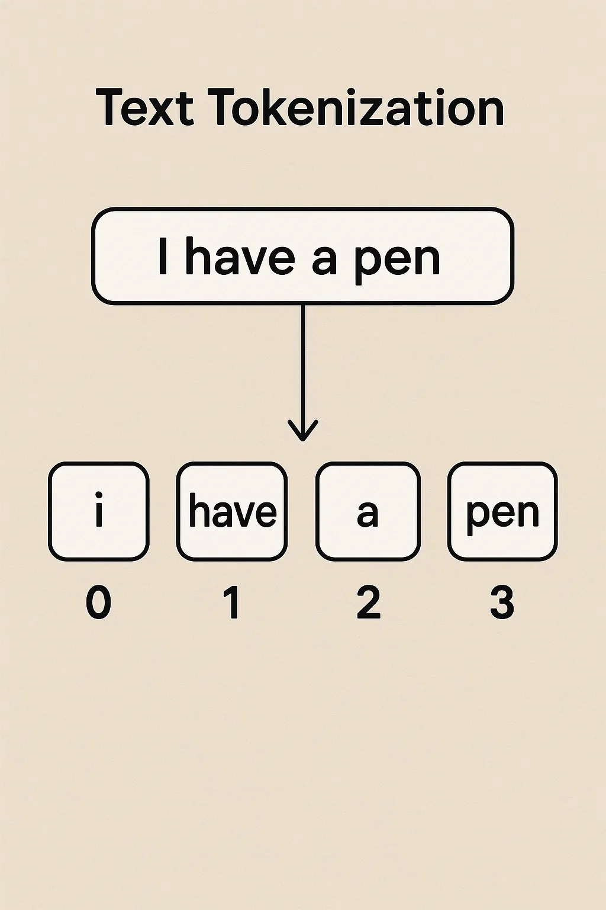
Step 3: Tokenize Text (Very Simplified)
def mock_tokenize(text, max_len=16):
# Convert each character to an integer (NOT real-world practice!)
tokens = [ord(c) % 1000 for c in text[:max_len]]
# Pad if necessary
if len(tokens) < max_len:
tokens += [0] * (max_len - len(tokens))
return tokens

Slide 40
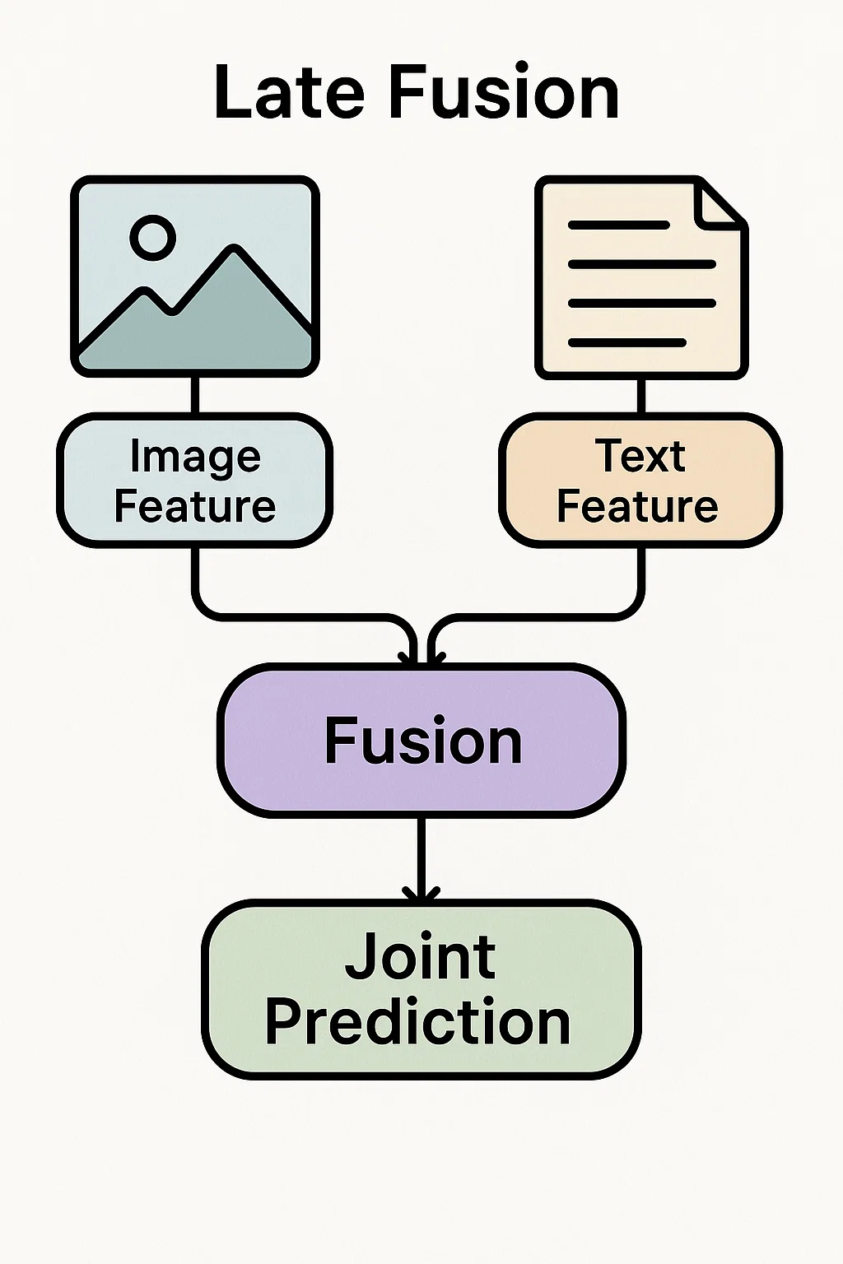
Step 4: Training Loop (Conceptual)
model = LateFusionModel()
criterion = nn.CrossEntropyLoss()
optimizer = torch.optim.Adam(model.parameters(), lr=1e-3)
# Example training loop
model.train()
for epoch in range(2): # Just 2 epochs for demo
for text_batch, genes_batch, labels_batch in dataloader:
# Mock tokenize
token_ids_batch = [mock_tokenize(t) for t in text_batch]
token_ids_batch = torch.tensor(token_ids_batch, dtype=torch.long)
# Forward pass
logits = model(token_ids_batch, genes_batch)
loss = criterion(logits, torch.tensor(labels_batch, dtype=torch.long))
# Backprop
optimizer.zero_grad()
loss.backward()
optimizer.step()
print(f"Epoch {epoch+1}, Loss: {loss.item():.4f}")
The full training cycle: tokenize, forward, calculate loss, back‑prop, update—repeat. Swap in a real tokenizer or a deeper encoder, add a validation split, and you’ve got a production‑ready multimodal pipeline.

Slide 41
05
Graph Neural Networks and Multimodal Data
Introduction to Graph Neural Networks
Connecting Graph Neural Networks with Multimodal Integration
Exercise 3

Slide 42
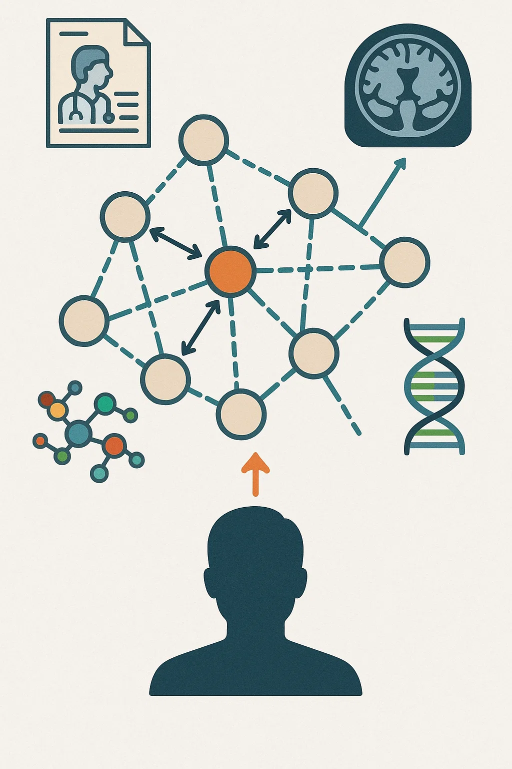
Introduction to Graph Neural Networks
Definition: A Graph Neural Network processes data represented as a graph (nodes + edges). Nodes have features (e.g., clinical data), and edges define relationships (e.g., shared biomarkers).
Key Mechanism: Message Passing: GNNs iteratively aggregate information from each node’s neighbors, updating node embeddings and capturing the graph’s global structure.
Why GNNs?
Can fuse multimodal data at the node level (e.g., imaging + text + genomics).
Leverages clinical or biological relationships as edges.
Learns to generate node- or graph-level predictions (e.g., patient outcomes).
Applications in Precision Medicine
Integrates diverse data sources.
Respects complex network structure of genes, proteins, and clinical similarities.
Drives more personalized, data-driven treatment decisions.

Slide 43
Connecting Graph Neural Networks with Multimodal Integration
Multimodal Machine Learning Model: GNN Synergy: Represent multiple data sources (genomics, imaging, clinical notes) as nodes and edges in a shared graph. GNNs naturally handle heterogeneous node features, capturing complex biological and clinical relationships.
Late Fusion Techniques: GNN Synergy: Generate embeddings from different models (e.g., imaging-based CNN, text-based NLP) and integrate them into a final GNN layer or fusion module. This ensures each modality’s specialized model informs the final predictive graph structure.
Bayesian Approaches: GNN Synergy: Incorporate prior knowledge (e.g., known biomarker interactions or molecular pathways) as initial graph structure or edge priors. Update beliefs about node/edge parameters as new clinical or experimental data become available.
Preprocessing Techniques: GNN Synergy: Consistent cleaning, normalization, and encoding of each modality ensures high-quality node features. Reduces noise and biases, leading to more robust GNN-based inference.
Collaborative Frameworks: GNN Synergy: Domain experts (oncologists, bioinformaticians) help define relevant biological/clinical graph connections. Data scientists and statisticians refine GNN architectures and interpret results for clinical impact.
Data Stewardship and Governance: GNN Synergy: Securely manage sensitive patient data (HIPAA, GDPR) to maintain trust and integrity. Ensures ethical and compliant data sharing for constructing large-scale biomedical graphs.

Slide 44
Exercise 3:
Create gnn_precision_medicine_demo.py
GLBIO-2025/gnn_precision_medicine_demo.py at main · maese005/GLBIO-2025

Slide 45
06
Closing
Questions / Comments
30 min working session

Slide 46
THANK YOU

